Slide 1
Economics
France Economy: Past and Present
Group 10 :
Yash (131063)
Aatman (1401013)
Neel (1401024)
Chintan (1401026)
Raj (1401029)
Parth (1401056)
Ravi (1401058)
Charvik (1401079)

Slide 2
Table of Contents
Introduction
History of French Economy (18th century – 20th century)
Condition of French economy in the 21th century
Role of the government in the French economy.
Factors that affect the French economy
Economic parameters of the French economy: GDP, Inflation, BOP
Facts about the French economy
Conclusion

Slide 3
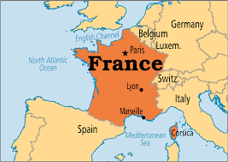
Introduction
France has always been amongst the most developed economies of the world.
France is one of Europe’s largest countries.
At present, France is the seventh largest economy in the world and the second largest in the EU.
France economy has a lot of products such as food, wines, metal and aircraft, tourism, etc.
We now present our studies on the history and present of the French economy.

Slide 4
History of the French Economy: 18th Century
France experienced a slow economic and demographic recovery in the first decades of the 18th century
The economy of Renaissance France was, for the first half-century, marked by a dynamic demographic growth and by developments in agriculture and industry.
Until 1795, France was the most populated country in Europe and the third most populous country in the world, behind only China and India, with an estimated population of 29 million in 1800.
France was rural country with less than 10% population in urban areas, though this number increased during the Renaissance
Local agricultural production of a variety of food products increased.

Slide 5
History of the French Economy: 18th Century
Starting in the late 1730s and early 1740s, and continuing for the next 30 years, France's population and economy underwent an important expansion. Rising prices, particularly for agricultural products, were extremely profitable for large landholders.
Farming of recent New World crops, such as maize and potatoes, continued to expand and provided an important supplement to the diet.
The most dynamic industries of the period were mines, metallurgy and textiles.
By the last decades of the century, French industries continued to develop. Mechanization was introduced, factories were created, and monopolies became more common.
The economy did poorly in 1790-96 as industrial and agricultural output dropped, foreign trade plunged, and prices soared.

Slide 6
History of the French Economy: 19th Century
1800-1814 was the Napoleon era, Napoleon paid for his expensive wars by multiple means, starting with the modernization of the financial system. He conscripted soldiers at low wages, raised taxes, placed large-scale loans, sold lands formerly owned by the Catholic Church, sold Louisiana to the United States, plundered conquered areas and seized food supplies, and levied requisitions on countries he controlled, such as Italy
The economy stimulated production at the cost of investment and growth (production of armaments and other military supplies, fortifications)
The rampant inflation after the Revolution was halted by not printing the new currency quite as fast during this time.

Slide 7
History of the French Economy: 19th Century
Paris emerged as an international centre of finance in the mid-19th century second only to London
Industrialization was one of the prime events for the French in the 19th century. The development of road and rail systems, social infrastructure, modernization and improvement in industry, lead to growth in the economy.
The level of living for industry workers was very low which saw resistance movements by people against the government to improve the living standards.
Education was made a high priority of successive French governments, leading to reduction in unemployment.
By the end of the 19th century, France, comparatively, had lost competitiveness against war-footing neighbour Germany, and Great Britain.

Slide 8
History of the French Economy: 20th Century
World war 1 had severe impacts all over EU, specially France:
The economy was seriously hurt by the German seizure of major industrial areas in the northeast. While the occupied area in 1913 contained only 14% of France's industrial workers, it produced 58% of the steel, and 40% of the coal. This lead to considerable increase in demand and hence in the inflation.
Because of support from America the economy was able to start recovering by 1917 by importing food, money and raw materials. Although this ruins the balance of payment, it is a better situation than what could have been otherwise.
The war damages amounted to about 113% of the GDP of 1913, becoming the destruction of productive capital and housing.
The national debt rose from 66% of GDP in 1913 to 170% in 1919, reflecting the heavy use of bond issues to pay for the war
Inflation was severe, with the franc losing over half its value against the British pound

Slide 9
History of the French Economy: 20th Century
Decade | Avg Growth Rate
1900-1910 | 2.27%
1910-1920 | 1.89%
1920-1930 | 4.43%
1930-1940 | 0.63%
1940-1950 | 2.16%
1950-1960 | 3.85%
1960-1970 | 4.98%
1970-1980 | 3.10%
1980-1990 | 2.02%
1990-2000 | 1.30%
The great depression of 1930:
The worldwide decline after 1929 affected France a bit later than other countries, hitting around 1931.
The depression was relatively mild: unemployment peaked under 5%, the fall in production was at most 20% below the 1929 output; there was no banking crisis
Although, the depression did have adverse effects on the local economy.
France's relatively high degree of self-sufficiency meant the damage was considerably less than in nations like Germany.
On the left is a table of the average growth rate in the 20th century.

Slide 10
History of the French Economy: 20th Century
1940: World War II
Conditions in Vichy France (under German occupation) were very harsh, because the Germans stripped France of millions of workers (as prisoners of war and "voluntary" workers), and as well stripped much of the food supply, while demanding heavy cash payments. It was a period of severe economic hardship
In 1940 the government took direct control of all production, which was synchronized with the demands of Germans, and replaced free trade unions with compulsory state unions that dictated labour policy without regard to the workers.
Nazi Germany kept nearly 2.5 million French Army POWs as forced labourers throughout the war. The shortage of volunteers led the Vichy government to pass a law in September 1941 that effectively deported workers to Germany, where, they constituted 17% of the labour force by August 1943.

Slide 11
History of the French Economy: 20th Century
After 1945: Post War Period
The great hardships of wartime, and of the immediate post-war period, were succeeded by a period of steady economic development, in France, now often fondly recalled there as "The Thirty Glorious Years"
Along with industrial and technological advances, social welfare for workers was also introduced.
France signed a treaty with US that waved off a large part of its debt. (Blum-Byrnes agreement, and they gained $2 Billion due to this)
By the end of the 20th century, France once again was among the leading economic powers of the world. By the year 2000 there was some fraying around the edges: people in France were asking whether France alone, without becoming even more an integral part of a pan-European economy, would have sufficient market presence to maintain its position, in an increasingly globalized economic world.

Slide 12
Condition of French economy in the 21th century
The 21st century has been good progress for the French economy, with decreasing deficits and increase in social welfare
The investment opportunities, start up opportunities, employment opportunities are high in France. Economic freedom individually (and also for industries) is very high.
Economic growth rate has been projected to increase by ~1.5% in 2016 and 2017 due to low crude prices, less fiscal contraction, cumulative effects of sustained monetary assets. Rising wages, exchange rates, stabilising energy prices should bring an increase in inflation.
Budget deficit should reduce IF spending is reduced while income taxes and social security revenues from the population, as share of GDP, are reduced.

Slide 13
Role of the government
The government at one time had majority ownership in many commercial banks, some key industries, and various utilities, including the telephone system.
Currently the government's role in the economic sphere is much less than before, especially because of the requirements of the European Union (EU).
Since the early 1990s, French companies have faced competition from their European counterparts which are getting less help from the government.
In an effort to privatize the state-owned industries, the government is selling off its shares in Telecom and Air transport, along with companies from the insurance, banking, and defence industries.
The government has since reduced its holdings in many companies, although it still controls energy production, public transportation, and defence industries.

Slide 14
Factors affecting the French Economy
Balance of payments:
Since 2005, France has maintained a current account deficit, predominantly driven by trade in goods. Yet, in 2013, Frances trade deficit shrank to its lowest level since 2010, although this decrease was mainly caused by the fact that exports fell less rapidly than imports.
France was ranked 10 in the world for incoming FDI in 2010 and has historically been a leading FDI destination. However, FDI experienced a large decline in 2013, contracting 77 % The countries with the largest investments in France are the US, Germany, Italy and the UK.
Fiscal Policies:
The aim of the Fiscal policies implemented are usually to (1) Improve Unemployment Rates, (2) Control Inflation, (3) Stabilize Business Cycle

Slide 15
Factors affecting the French Economy
Trading:
France consumes large amounts of imported consumer goods, which are less expensive than products Made in France. France is also a net importer of oil and remains sensitive to changes in prices
France is a relatively open economy in European Nations, but some barriers to trade are present. Among goods, many agricultural products are protected at the European level, a policy that France advocated, and French farmers have historically been dependent on government subsidies.

Slide 16
Factors affecting the French Economy
Imports - Exports:
In recent years, France has been a net importer with a large amount of goods and services being imported. (Machinery, oil, vehicles)
France also exports a wide range of goods and services, and has an export-to-GDP ratio close to 30%. France is one of the worlds largest exporters of farm and agricultural products and is renowned for its wine, spirits and cheeses.
Majority of Frances exports are to European nations, with only around one-third of all exports going to economies outside Europe.
Population, Employment, Service and Industry:
Low population-, less contribution of agriculture to the GDP, more focus on service sector, and characteristics similar to that of a developed country are seen in the French economy too.

Slide 17
Factors affecting the French Economy
Economic Policies
Since the 1980s, the government of France has favoured capitalism and market-orientated policies. The government has either partially or fully privatized many national industries, including Air France, France telecom and Renault, and today Frances leaders remain committed to capitalism.
The government still governs the agricultural sector.
Despite recent changes to France’s policies, greater reform may be needed to kick-start the economy. France is ranked 141 out of 144 countries on hiring and firing practices according to the World Economic Forums Global Competitiveness Report
Housing market and Real estate in France are under stress due to high prices and low market activity.

Slide 18
Factors affecting the French Economy
Monetary Policy:
The Banque de France is the central bank of France and is responsible for the implementation of Frances monetary policy.
Since 1999, France has followed the common monetary policy of the Eurozone set by the European Central Bank (ECB). The primary objective of the ECBs monetary policy is to maintain price stability within the Eurozone. Today, the Banque de France is linked to the ECB and implements the interest rate policy set by the European System of Central Banks.
The ECB is committed to keeping inflation below, but close to, 22 % over the medium term. In order to achieve this goal, the ECB uses a set of monetary policy instruments, setting the key deposit rate and benchmark refinancing rate.
Since the economic crisis, inflation has fallen below 1 %, into the danger zone, causing the ECB to take unprecedented monetary policy actions. In 2014, the ECB cut the main refinancing rate to a record low of 0.15 % and became the first major central bank to ever adopt a negative deposit rate.

Slide 19
Factors affecting the French Economy
Exchange Rate policy:
Since the adoption of the Euro, France’s exchange rate policy has been determined by the ECB. The Eurozone members decided in 1998 to adopt a flexible exchange rate regime, allowing the euro to float freely. By allowing the euro to float, the ECB targets interest rates rather than exchange rates and does not intervene in foreign exchange markets.
The euro is the world’s second largest reserve currency after the US $, and is used as a peg for several countries outside of the Eurozone.
The $/€ exchange rate has floated within a range of 0.90$/€ per euro and 1.47$/€. After reaching its peak in 2008, the euro depreciated amid fears of a potential Eurozone breakup caused by the Greek sovereign debt crisis. While the euro has gained ground since then, uncertainty regarding the evolution of the debt crisis continues to impact the rate.

Slide 20
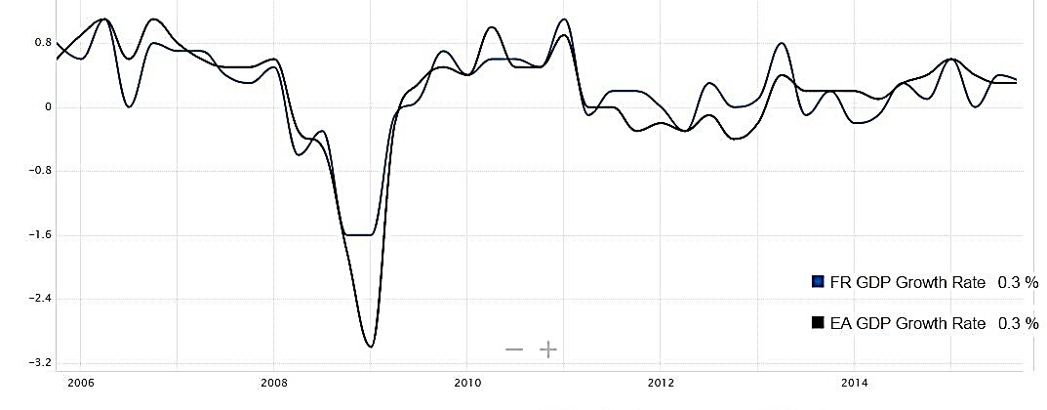
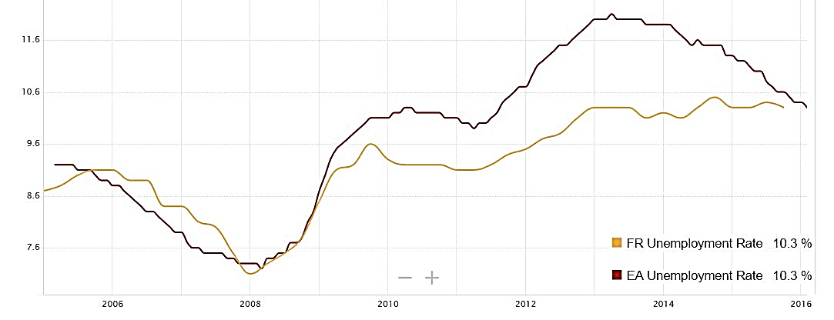
Parameters: GDP, Unemployment, BOP
GDP Growth Rate in France was last registered as 0.3% in Q4 2015.
Euro Area GDP Growth Rate was 0.3% in Q4 2015.
Both of them follow similar trends.
Unemployment Rate in France went down to 10.3% in Q4 2015 (from 10.4% in Q3 2015)
Euro Area Unemployment Rate was reported at 10.3% in Feb 2016.
BoP: € -5.177 billion
GDP per capita: $36000 (USD), which is higher than most other economies in the world.

Slide 21
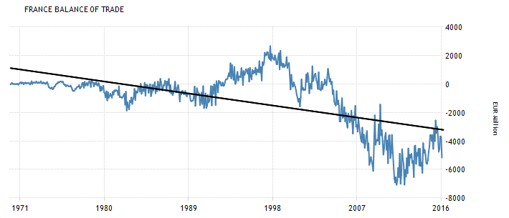
Parameters: GDP, Unemployment, BOP
Since 2004, France has been recording trade deficits due the gradual erosion of the export-oriented industry, the appreciation of the EUR and the increasing dependency on imports of energy and manufactured products.
In 2015, the biggest trade deficits were recorded with: China, Germany, Belgium, Italy, the Netherlands

Slide 22
Parameters: Import, Export
France exports mainly aircraft, food, chemicals excluding perfumes, industrial and agricultural machinery, computers, electronics, metal products, pharmaceuticals (6 %), motor vehicles (6 %), textiles, clothing (5 %) and electrical equipment (4 %).
Main export partners are: Germany (16 %), the US, Spain, Italy, the UK and Belgium (7 % each), China and the Netherlands (4 % each). [

Slide 23
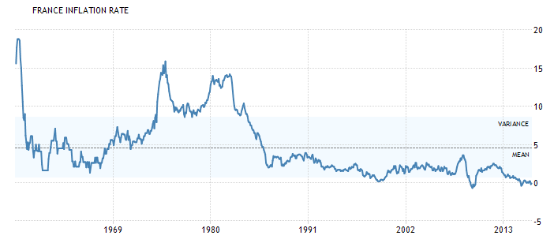
Parameters: Inflation
Based on inflation:
Inflation in France is calculated by the Consumer Price Index (CPI) method.
The average rate of inflation in France stays around 1.25% since 2000, beside some tiny ups and downs in 2003 and 2008.
The inflation rate in France has been 1.36% (2012), 0.69% (2013), 0.06% (2014), 0.18% (2015), hence it is not a major factor in the French economy (unlike India)

Slide 24
Facts about the French economy
France has the world's sixth-largest economy by nominal figures and the ninth largest economy by PPP figures.
It is the third-largest economy in Europe after Germany and The UK
The chemical industry is a key sector for France, helping to develop other manufacturing activities and contributing to economic growth.
In 2010, Credit Suisse's Global Wealth Report ranked France the wealthiest European country with 2.6 million dollar-millionaires, and the world's 4th wealthiest nation in aggregate household wealth.
According to the IMF, in 2013, France was ranked 20th in the world by GDP per capita with $44,099 per inhabitant.

Slide 25
Facts about the French economy
In 2013, France was listed on the United Nations' Human Development Index with 0.884 (very high human development) and 25th on the Corruption Perceptions Index.
With at least 75 million foreign tourists per year, France is the most visited country in the world and maintains the third largest income based on tourism
France's GDP growth was 1.2% in 2015.
The unemployment rate (including overseas territories) increased from 7.8% in 2008 to 10.4% in the fourth quarter of 2014. Youth unemployment in metropolitan France decreased from 25.4% in 2012 to 24.3% in 2014.

Slide 26
Facts about the French economy
The French Government is implementing austerity measures that eliminate tax credits and freeze most government spending in an effort to bring the budget deficit under the 3 percent euro-zone ceiling, by 2013, and to highlight France's commitment to fiscal discipline at a time of intense financial market scrutiny of euro-zone debt levels.
The budget deficit rose sharply from 3.3% of GDP in 2008 to 7.5% of GDP in 2009 before improving to 4% of GDP in 2014 and 2015, while France's public debt rose from 68% of GDP to more than 98% in 2015, and may hit 100% in 2016.
In the French economy, agriculture plays a larger role than in the economies of most other industrial countries.
French Euro is 93% stronger than the average currency for all countries.

Slide 27
Conclusion
So we understood that in the past, with higher rural population, the French economy faced quite a few hardships, which were gradually fixed in ~200 years of reforms, development, industry, urbanization amongst wars, revolutions, and famines, and because of a large population at that time they were unable to have fast recovery.
By the end of the 20th century it became one of the most of powerful nations, despite a few economic factors being on an undesirable level.
By decreasing the reliance on agriculture, improving the BOP deficit by more exports, increasing in education and reducing unemployment, the French economy has been able to do well despite the other countries in the EU being in a flat condition.

Slide 28
Conclusion
If India wants to become stable like the French economy quite a few factors must be addressed, such as:
Improvement of the monetary and fiscal policies
Become more self reliant in increasing local production
Balancing a 6 billion dollar BOP deficit
Increasing the exports to balance BOP (like IT sector outsource services)
We cant control the population much, neither can we reduce it, so we must increase education so that the people become skilled
Increase the reliance on service and industry rather than on agriculture, and improve the marginal productivity in agriculture sector.
Reduce poverty by all possible means.

Slide 29
References
http://about-france.com/geo/french-economy.htm
http://www.heritage.org/index/country/france
http://www.focus-economics.com/countries/france
http://www.nationsencyclopedia.com/economies/Europe/France-OVERVIEW-OF-ECONOMY.html
http://www.sjsu.edu/faculty/watkins/france0.htm
http://www.countriesquest.com/europe/france/history/france_in_the_late_middle_ages/the_reshaping_of_france/19th-century_french_economy_and_society/industrialization_in_france.htm
http://www.gouvernement.fr/en/economy-and-finance

Slide 30
References
https://en.wikipedia.org/wiki/Economic_history_of_France
http://www.inflation.eu/inflation-rates/france/historic-inflation/cpi-inflation-france.aspx
http://www.businessinsider.com/14-reasons-france-is-under-fire-2012-4?IR=T#high-costs-of-employing-workers-makes-doing-business-expensive-particularly-in-comparison-to-neighboring-germany-1
https://en.wikipedia.org/wiki/Economy_of_France
http://www.expatica.com/fr/about/France-facts-Economy_106943.html
http://www.heritage.org/index/country/france
http://www.infoplease.com/encyclopedia/world/france-economy.html

Slide 31
Thank You!

